Slide 1


Utility-Aware Social Event-Participant Planning
Jieying She†, Yongxin Tong‡, Lei Chen†
†The Hong Kong University of Science and Technology
‡Beihang University

Slide 2
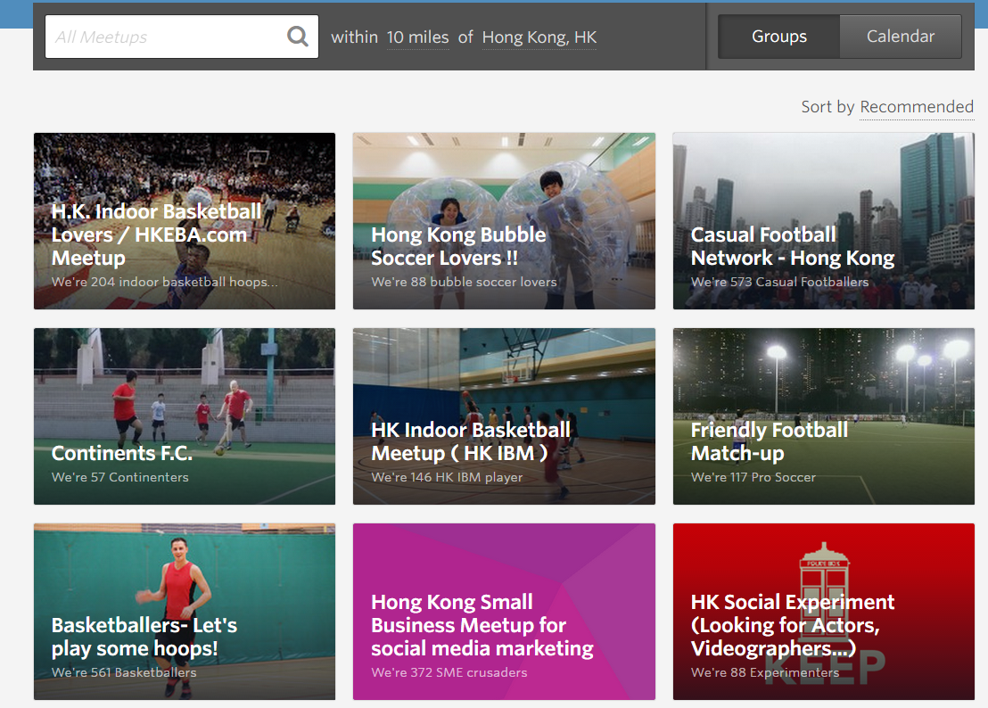
Introduction: Event-Based Social Network (EBSN)
A platform for users to organize and attend events
A Snapshot of Meetup

Slide 3
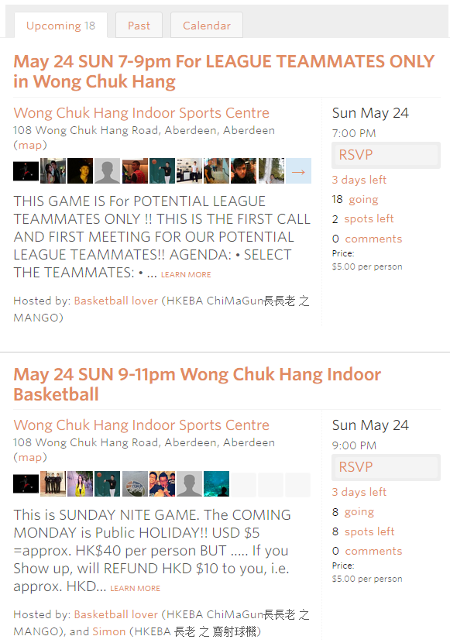
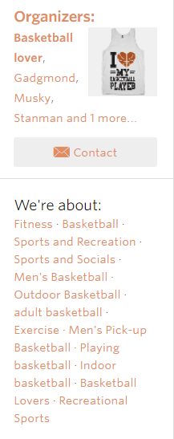

Slide 4
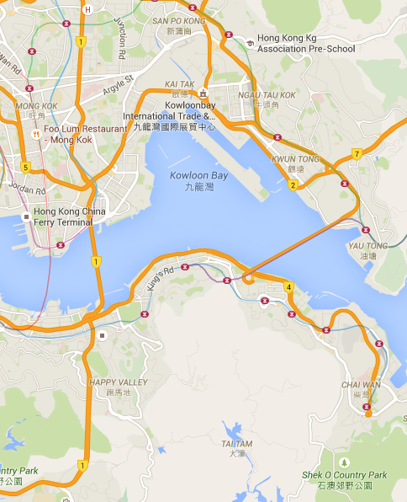
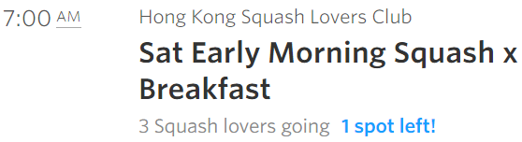





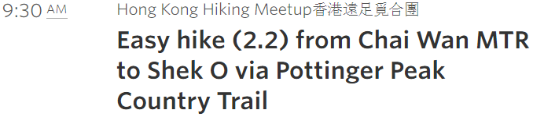


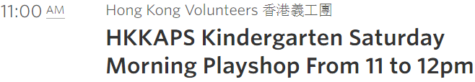

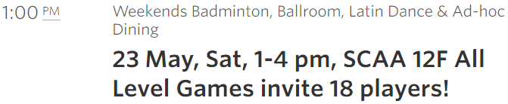



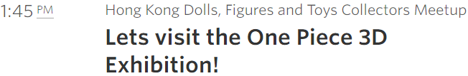



Slide 5
Motivation
Make proper social event-participant planning for users
Events have limited capacity/quotas
Two fundamental factors of planning should be considered
Time conflicts
Travel expenditure
Previous work
Assume each user attends one event [KDD’14]
Ignore location information and travel expenditure [ICDE’15]
On Social Event Organization, KDD’14
Conflict-Aware Event-Participant Arrangement, ICDE’15

Slide 6
Outline
1. Problem Definition
2. Algorithms
3. Experiments
4. Conclusion

Slide 7
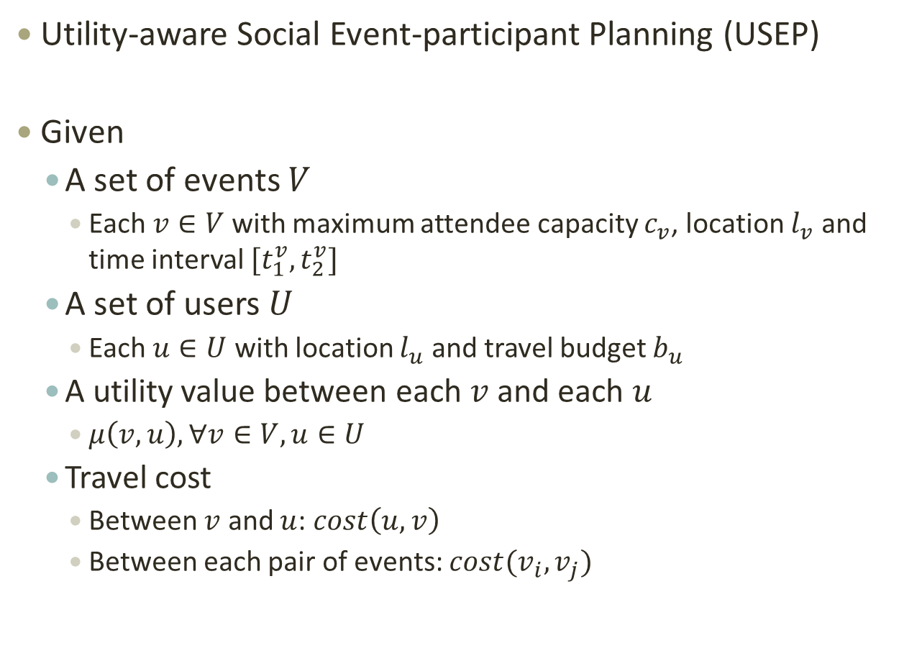
Problem Definition
Utility-aware Social Event-participant Planning (USEP)
Given
A set of events $V$
Each $v∈V$ with maximum attendee capacity $c_{v}$, location $l_{v}$ and time interval $[t_{1}^{v},t_{2}^{v}]$
A set of users $U$
Each $u∈U$ with location $l_{u}$ and travel budget $b_{u}$
A utility value between each $v$ and each $u$
$μ\left(v,u\right), ∀v∈V, u∈U$
Travel cost
Between $v$ and $u$: $cost\left(u,v\right)$
Between each pair of events: $cost(v_{i},v_{j})$

Slide 8
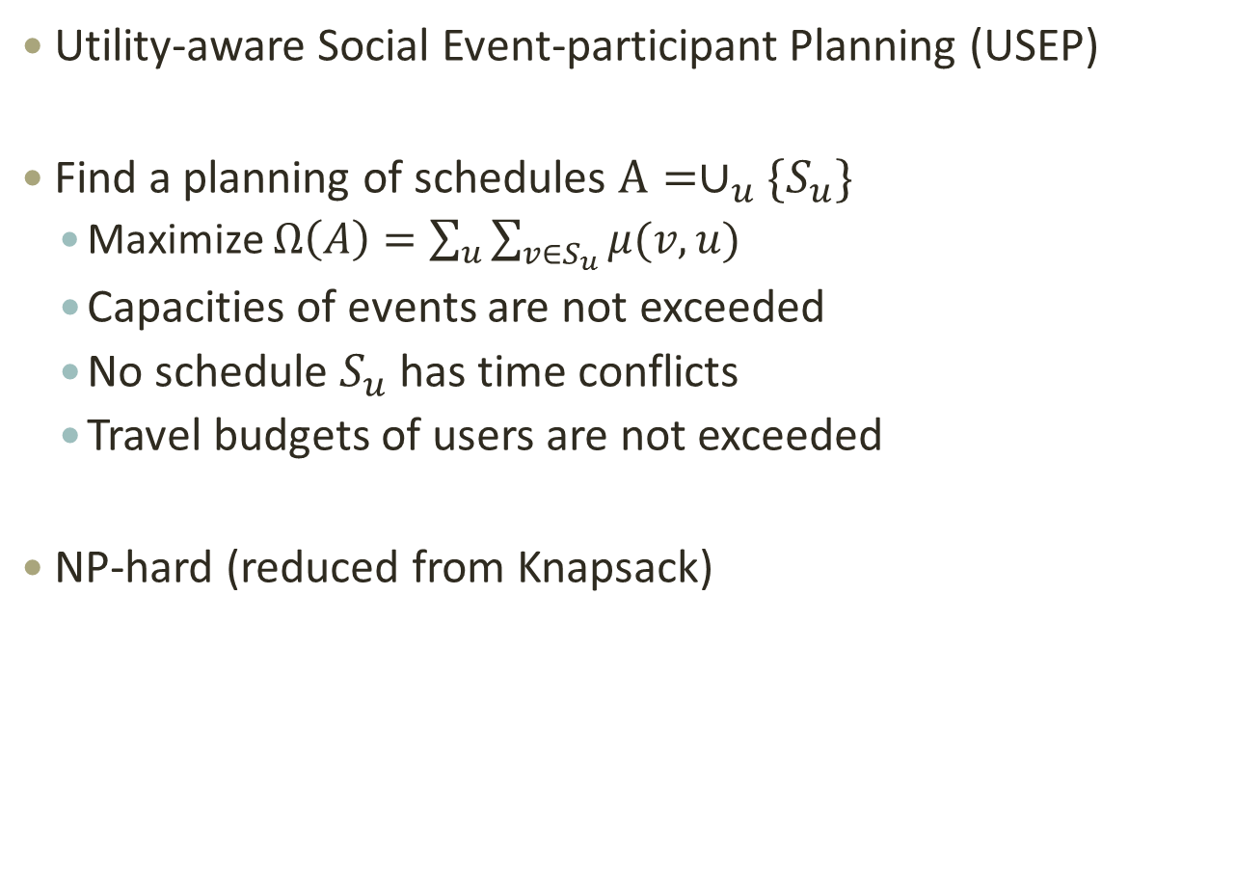
Problem Definition
Utility-aware Social Event-participant Planning (USEP)
Find a planning of schedules $A=∪_{u}\{S_{u}\}$
Maximize $Ω\left(A\right)=\sum_{u}{\sum_{v∈S_{u}}{μ(v,u)}}$
Capacities of events are not exceeded
No schedule $S_{u}$ has time conflicts
Travel budgets of users are not exceeded
NP-hard (reduced from Knapsack)

Slide 9
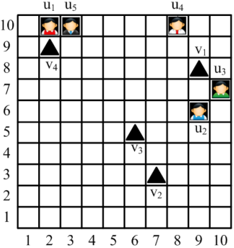
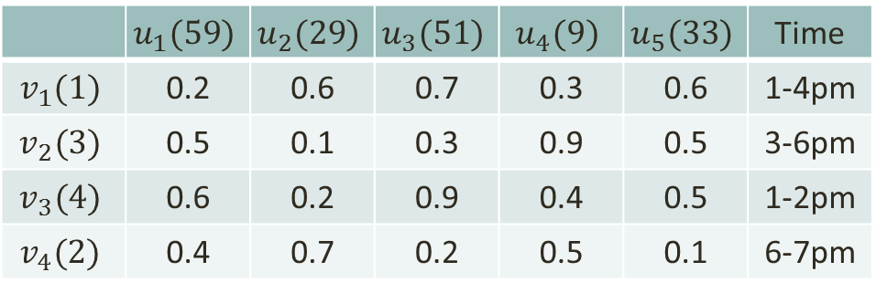

Algorithms: (1)RatioGreedy
Basic idea
Maintain a heap and greedily add the unassigned pair with the largest $ratio$ value
$ratio\left(v,u\right)=\frac{μ(v,u)}{inc_cost(v,u)}$
$inc_cost(v,u)$: additional travel cost induced
Travel budget
 | $$u_{1}(59)$$ | $$u_{2}(29)$$ | $$u_{3}(51)$$ | $$u_{4}(9)$$ | $$u_{5}(33)$$ | Time
$$v_{1}(1)$$ | 0.2 | 0.6 | 0.7 | 0.3 | 0.6 | 1-4pm
$$v_{2}(3)$$ | 0.5 | 0.1 | 0.3 | 0.9 | 0.5 | 3-6pm
$$v_{3}(4)$$ | 0.6 | 0.2 | 0.9 | 0.4 | 0.5 | 1-2pm
$$v_{4}(2)$$ | 0.4 | 0.7 | 0.2 | 0.5 | 0.1 | 6-7pm
Capacity

Slide 10
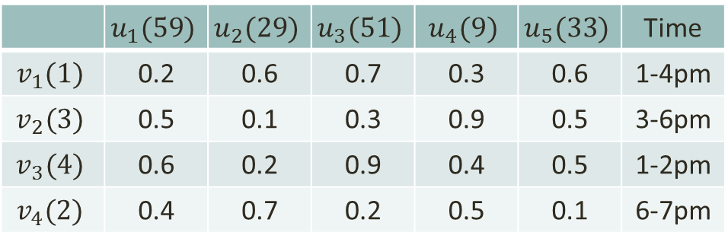
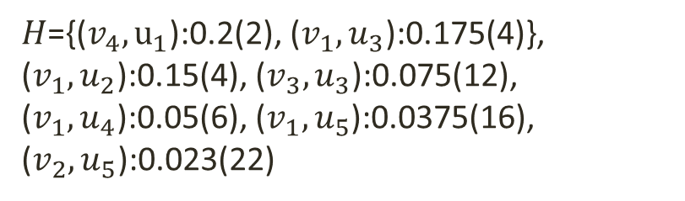


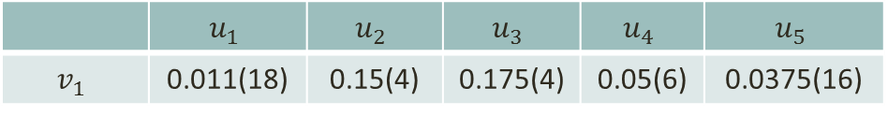
Algorithms: (1)RatioGreedy
Basic idea
Maintain a heap and greedily add the unassigned pair with the largest $ratio$ value
 | $$u_{1}(59)$$ | $$u_{2}(29)$$ | $$u_{3}(51)$$ | $$u_{4}(9)$$ | $$u_{5}(33)$$ | Time
$$v_{1}(1)$$ | 0.2 | 0.6 | 0.7 | 0.3 | 0.6 | 1-4pm
$$v_{2}(3)$$ | 0.5 | 0.1 | 0.3 | 0.9 | 0.5 | 3-6pm
$$v_{3}(4)$$ | 0.6 | 0.2 | 0.9 | 0.4 | 0.5 | 1-2pm
$$v_{4}(2)$$ | 0.4 | 0.7 | 0.2 | 0.5 | 0.1 | 6-7pm
 | $$u_{1}$$ | $$u_{2}$$ | $$u_{3}$$ | $$u_{4}$$ | $$u_{5}$$
$$v_{1}$$ | 0.011(18) | 0.15(4) | 0.175(4) | 0.05(6) | 0.0375(16)
$H$={($v_{1}$, $u_{3}$):0.175(4)}
$H$={($v_{4},u_{1}$):0.2(2), ($v_{1},u_{3}$):0.175(4)}, ($v_{1},u_{2}$):0.15(4), ($v_{3},u_{3}$):0.075(12), ($v_{1},u_{4}$):0.05(6), ($v_{1},u_{5}$):0.0375(16), ($v_{2},u_{5}$):0.023(22)

Slide 11
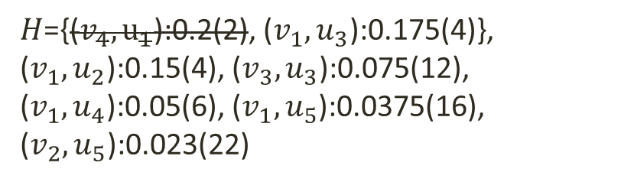
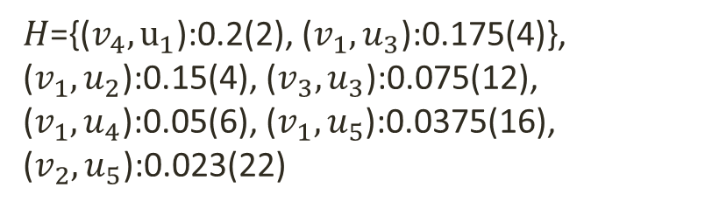
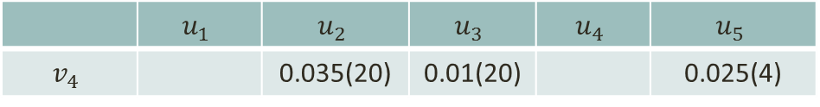
Algorithms: (1)RatioGreedy
Basic idea
Maintain a heap and greedily add the unassigned pair with the largest $ratio$ value
 | $$u_{1}(59)$$ | $$u_{2}(29)$$ | $$u_{3}(51)$$ | $$u_{4}(9)$$ | $$u_{5}(33)$$ | Time
$$v_{1}(1)$$ | 0.2 | 0.6 | 0.7 | 0.3 | 0.6 | 1-4pm
$$v_{2}(3)$$ | 0.5 | 0.1 | 0.3 | 0.9 | 0.5 | 3-6pm
$$v_{3}(4)$$ | 0.6 | 0.2 | 0.9 | 0.4 | 0.5 | 1-2pm
$$v_{4}(2)$$ | 0.4 | 0.7 | 0.2 | 0.5 | 0.1 | 6-7pm
 | $$u_{1}$$ | $$u_{2}$$ | $$u_{3}$$ | $$u_{4}$$ | $$u_{5}$$
$$v_{4}$$ |  | 0.035(20) | 0.01(20) |  | 0.025(4)
$H$={($v_{4},u_{1}$):0.2(2), ($v_{1},u_{3}$):0.175(4)}, ($v_{1},u_{2}$):0.15(4), ($v_{3},u_{3}$):0.075(12), ($v_{1},u_{4}$):0.05(6), ($v_{1},u_{5}$):0.0375(16), ($v_{2},u_{5}$):0.023(22)
$H$={($v_{4},u_{1}$):0.2(2), ($v_{1},u_{3}$):0.175(4)}, ($v_{1},u_{2}$):0.15(4), ($v_{3},u_{3}$):0.075(12), ($v_{1},u_{4}$):0.05(6), ($v_{1},u_{5}$):0.0375(16), ($v_{2},u_{5}$):0.023(22)

Slide 12
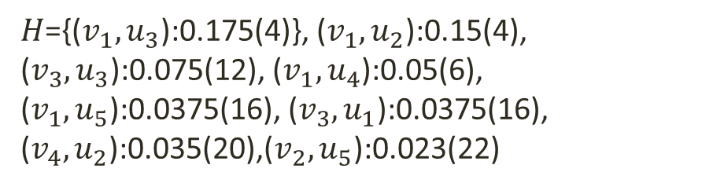
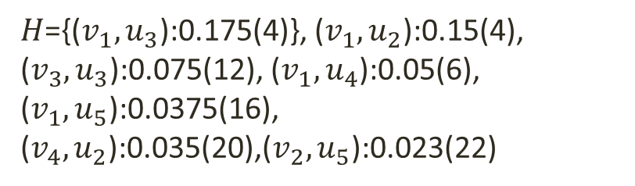
Algorithms: (1)RatioGreedy
Basic idea
Maintain a heap and greedily add the unassigned pair with the largest $ratio$ value
 | $$u_{1}(59)$$ | $$u_{2}(29)$$ | $$u_{3}(51)$$ | $$u_{4}(9)$$ | $$u_{5}(33)$$ | Time
$$v_{1}(1)$$ | 0.2 | 0.6 | 0.7 | 0.3 | 0.6 | 1-4pm
$$v_{2}(3)$$ | 0.5 | 0.1 | 0.3 | 0.9 | 0.5 | 3-6pm
$$v_{3}(4)$$ | 0.6 | 0.2 | 0.9 | 0.4 | 0.5 | 1-2pm
$$v_{4}(2)$$ | 0.4 | 0.7 | 0.2 | 0.5 | 0.1 | 6-7pm
 | $$u_{1}$$ | $$u_{2}$$ | $$u_{3}$$ | $$u_{4}$$ | $$u_{5}$$
$$v_{4}$$ |  | 0.035(20) | 0.01(20) |  | 0.025(4)
$H$={($v_{1},u_{3}$):0.175(4)}, ($v_{1},u_{2}$):0.15(4), ($v_{3},u_{3}$):0.075(12), ($v_{1},u_{4}$):0.05(6), ($v_{1},u_{5}$):0.0375(16), ($v_{3},u_{1}$):0.0375(16), ($v_{4},u_{2}$):0.035(20),($v_{2},u_{5}$):0.023(22)
$H$={($v_{1},u_{3}$):0.175(4)}, ($v_{1},u_{2}$):0.15(4), ($v_{3},u_{3}$):0.075(12), ($v_{1},u_{4}$):0.05(6), ($v_{1},u_{5}$):0.0375(16), ($v_{4},u_{2}$):0.035(20),($v_{2},u_{5}$):0.023(22)

Slide 13

Algorithms: (1)RatioGreedy
$$Ω\left(A\right)=3.6$$

Slide 14

Algorithms: (2)DeDP
Basic idea
Decomposed into |𝑈| problems
Find a schedule for each 𝑢 with a dynamic programming algorithm
Combine the results
 | $$u_{1}(59)$$ | $$u_{2}(29)$$ | $$u_{3}(51)$$ | $$u_{4}(9)$$ | $$u_{5}(33)$$ | Time
$$v_{1}(1)$$ | 0.2 | 0.6 | 0.7 | 0.3 | 0.6 | 1-4pm
$$v_{2}(3)$$ | 0.5 | 0.1 | 0.3 | 0.9 | 0.5 | 3-6pm
$$v_{3}(4)$$ | 0.6 | 0.2 | 0.9 | 0.4 | 0.5 | 1-2pm
$$v_{4}(2)$$ | 0.4 | 0.7 | 0.2 | 0.5 | 0.1 | 6-7pm

Slide 15

Algorithms: (2)DeDP
$$Ω\left(A\right)=4.6$$

Slide 16
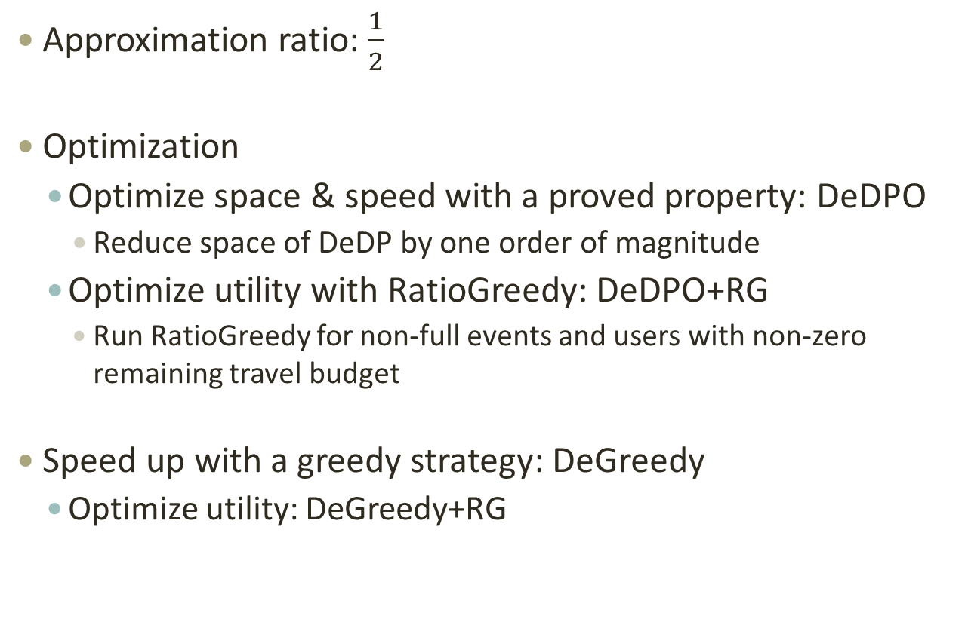
Algorithms: (2)DeDP
Approximation ratio: $\frac{1}{2}$
Optimization
Optimize space & speed with a proved property: DeDPO
Reduce space of DeDP by one order of magnitude
Optimize utility with RatioGreedy: DeDPO+RG
Run RatioGreedy for non-full events and users with non-zero remaining travel budget
Speed up with a greedy strategy: DeGreedy
Optimize utility: DeGreedy+RG

Slide 17
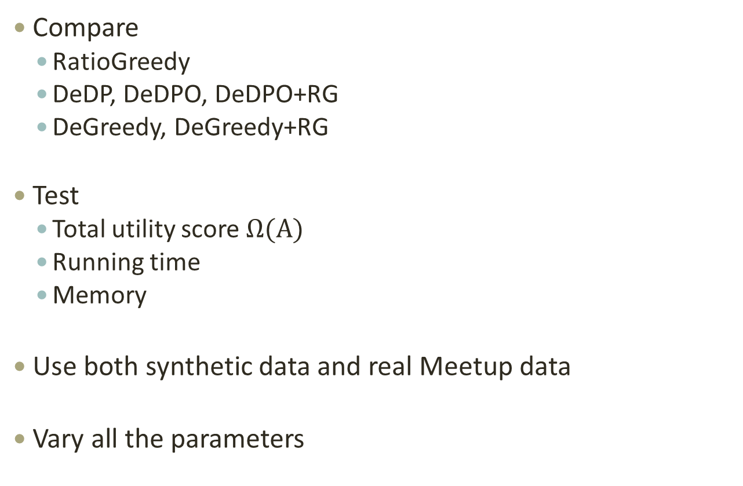
Experiments
Compare
RatioGreedy
DeDP, DeDPO, DeDPO+RG
DeGreedy, DeGreedy+RG
Test
Total utility score $Ω(A)$
Running time
Memory
Use both synthetic data and real Meetup data
Vary all the parameters

Slide 18
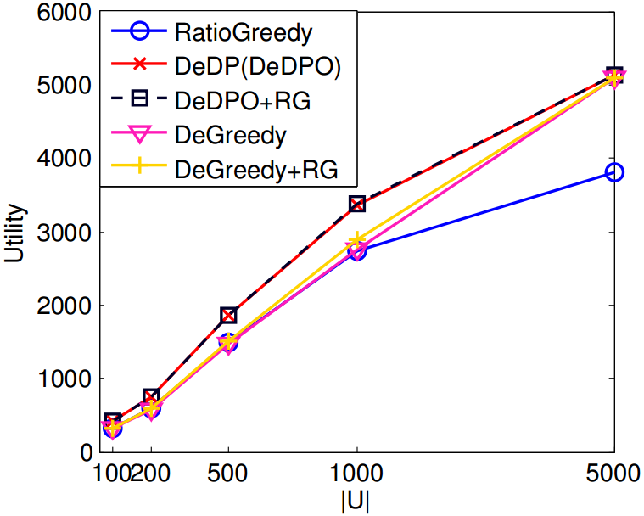
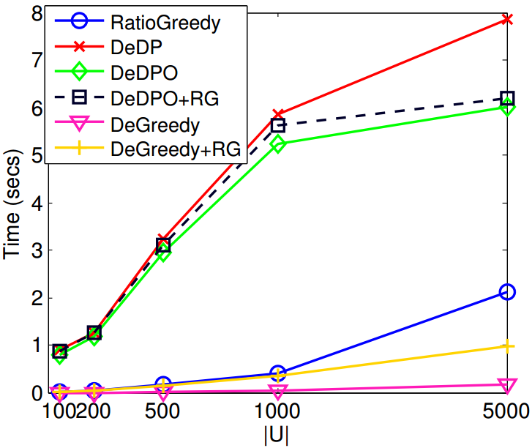
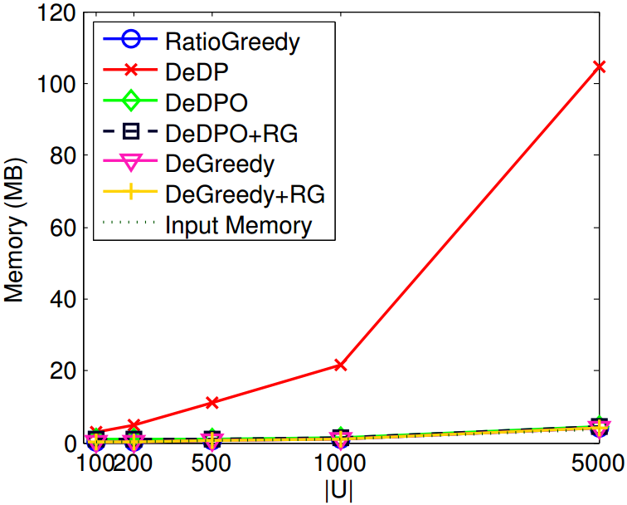
Experiments: Vary $|U|$

Slide 19
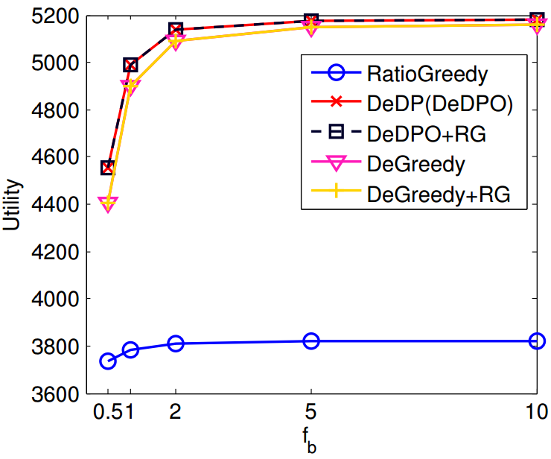
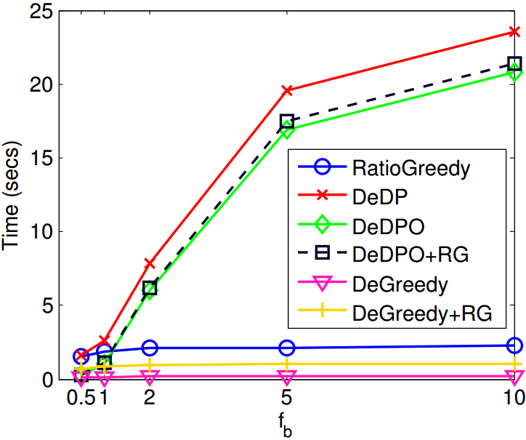
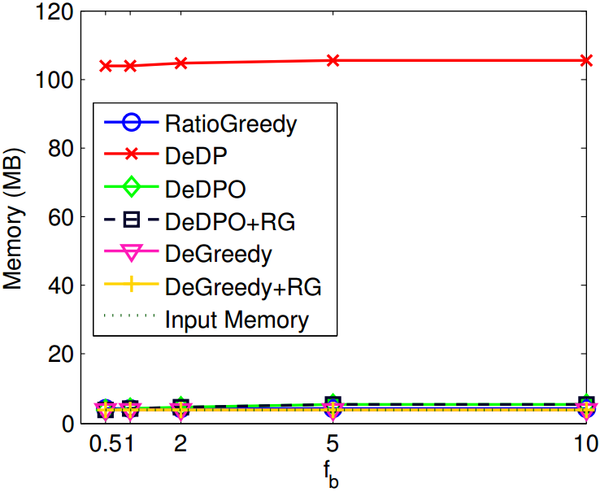

Experiments: Vary travel budget
$f_{b}$ controls budgets of users. Larger $f_{b}$ leads to larger budgets

Slide 20
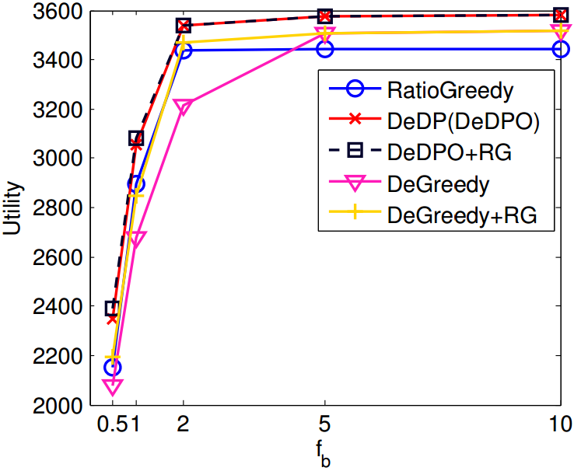
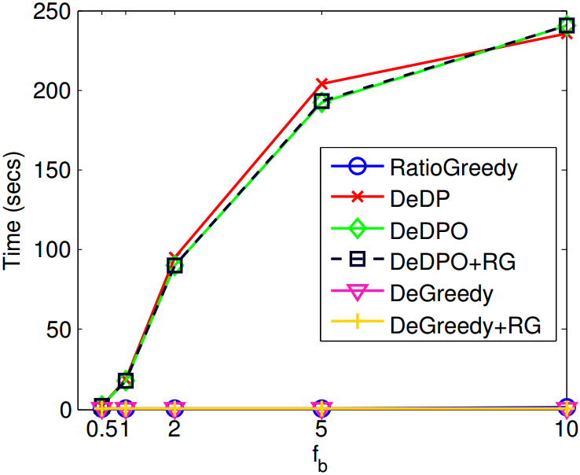
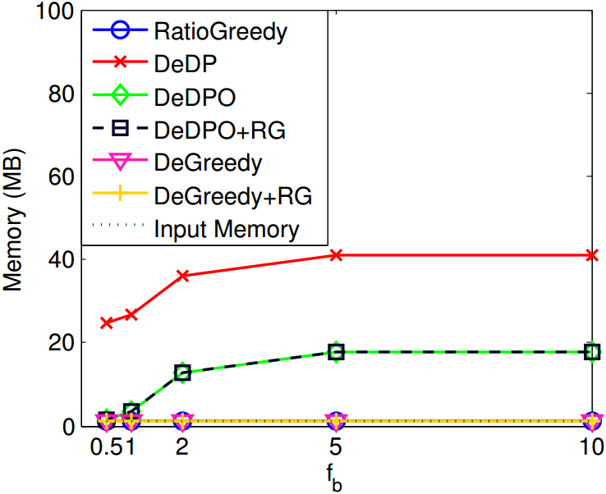
Experiments: Real Data (Meetup, Singapore)

Slide 21
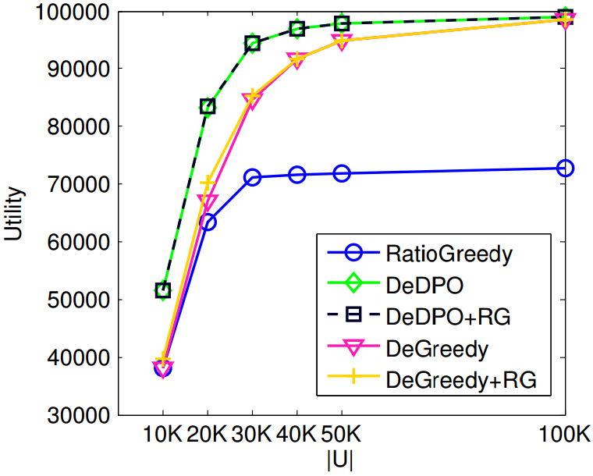
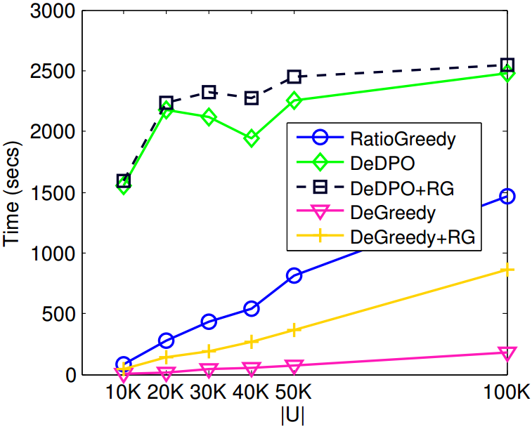
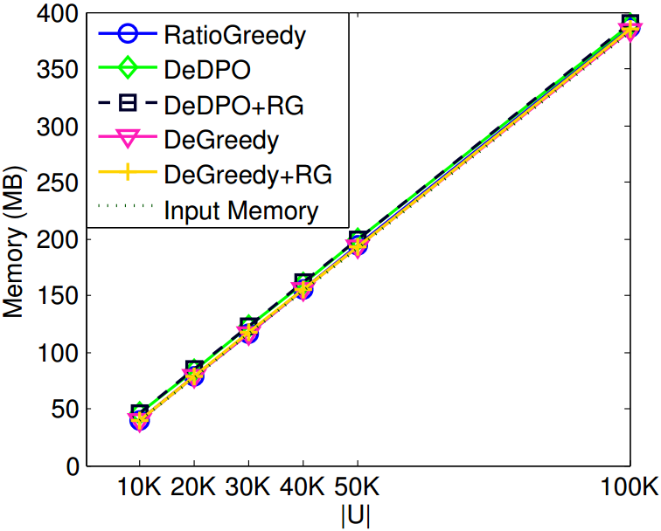
Experiments: Scalability ($\left|V\right|=500$)

Slide 22
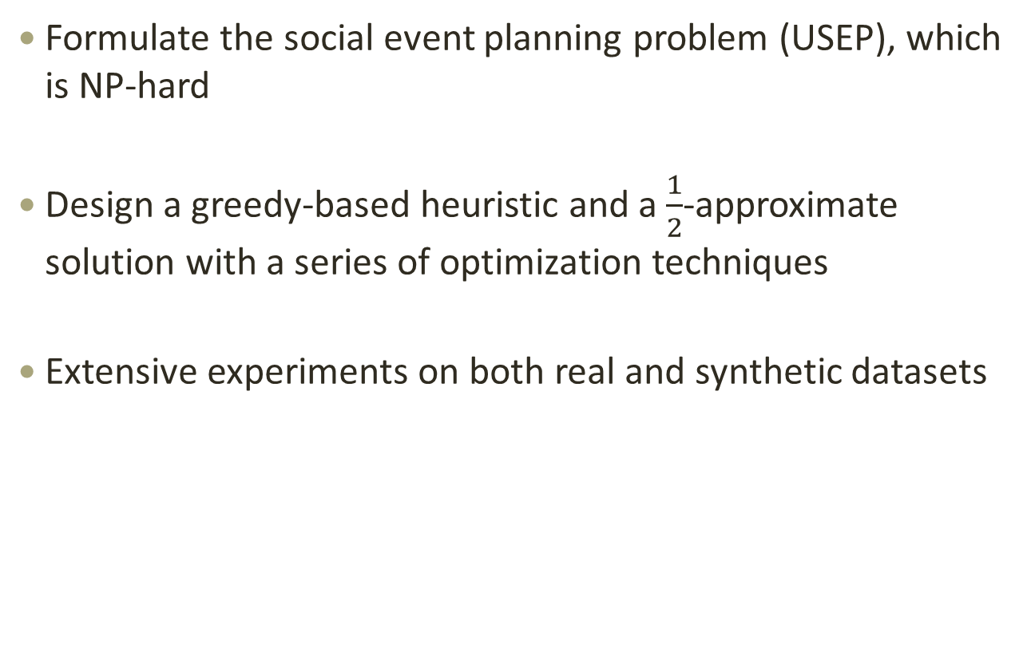
Conclusion
Formulate the social event planning problem (USEP), which is NP-hard
Design a greedy-based heuristic and a $\frac{1}{2}$-approximate solution with a series of optimization techniques
Extensive experiments on both real and synthetic datasets

Slide 23
Thank you

